Slide 1
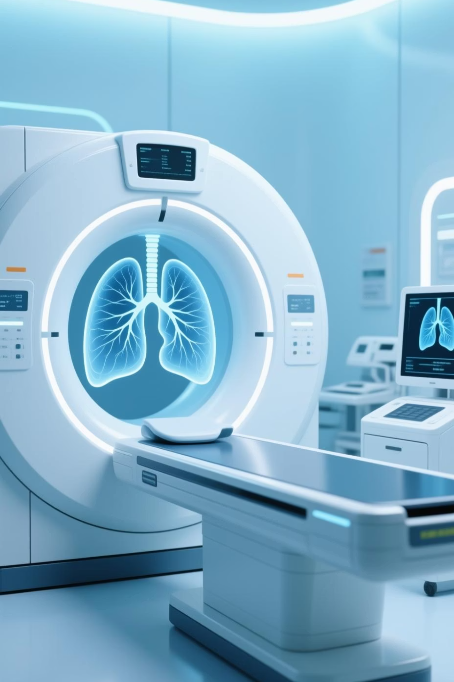
CNN-Based Lung Cancer Detection System
A comprehensive deep learning approach using Convolutional Neural Networks for automated detection of lung cancer from histopathology images, leveraging Keras and TensorFlow frameworks.
- Presented by Anurup Saha

Slide 2
Project Overview and Architecture
Model Specifications
Training Configuration
Sequential CNN architecture with three convolutional layers
Training samples: 2,000 images
Test samples: 400 images
Input shape: 100×100×3 (RGB images)
Epochs: 5 with batch size 64
Binary classification: Cancer vs. No Cancer
Optimiser: Adam with binary cross-entropy loss
Sigmoid activation for output layer

Slide 3
Data Preparation Pipeline
01
02
Data Generation
Shape Validation
Simulated synthetic data generation creates 100×100×3 RGB images with binary labels (0 or 1) for training and testing datasets.
Explicit reshaping ensures correct 4D tensor format: (samples, width, height, channels) matching model input requirements.
03
04
Normalisation
Train-Test Split
Pixel values scaled from 0-255 range to 0-1 range, improving model convergence and training stability.
Data segregated with 10% validation split during training for performance monitoring and overfitting prevention.

Slide 4





CNN Architecture Deep Dive
Conv2D Layer 1 (32 filters)
3×3 kernel with ReLU activation, followed by 2×2 max pooling for feature extraction from raw images.
Conv2D Layer 2 (32 filters)
Second convolutional layer with identical configuration, extracting higher-level features and spatial hierarchies.
Conv2D Layer 3 (32 filters)
Final convolutional layer capturing complex patterns, followed by flattening for dense layer processing.
Dense Layers
64-neurone hidden layer with ReLU, culminating in single sigmoid output neurone for binary classification probability.

Slide 5


Model Training Process
Training Execution
The model undergoes supervised training using the Adam optimizer with binary cross-entropy loss function, ideal for binary classification tasks.
A 10% validation split provides real-time performance feedback during training, helping identify potential overfitting early.
Technical Note: Ensure model.compile() is executed before model.fit() to properly initialise optimiser states and loss functions.

Slide 6
Key Training Parameters
Epochs
Batch Size
5 iterations through the complete training dataset, balancing learning time with model convergence.
64 samples per gradient update, optimising memory usage whilst maintaining stable gradient estimates.
Loss Function
Optimiser
Binary cross-entropy measures probability distribution difference between predicted and actual labels.
Adam algorithm adapts learning rates automatically, combining momentum and RMSprop advantages.

Slide 7

Model Evaluation Results
Performance Metrics
400
After training completion, the model is evaluated on the held-out test set of 400 images to assess generalisation capability.
Test Images
Evaluation dataset size
Key metrics include test loss (quantifying prediction errors) and test accuracy (percentage of correct classifications).
2
Classes
Binary classification output

Slide 8
Real-World Prediction Pipeline
Image Loading
Prediction
JPEG histopathology image loaded using tf.keras.utils.load_img with RGB colour mode specification.
Model generates sigmoid probability output, with threshold < 0.5 indicating no cancer, ≥ 0.5 indicating cancer detection.
1
2
3
4
Preprocessing
Classification
Image resized to 100×100 pixels, converted to NumPy array, normalised to 0-1 range, and dimensions expanded.
Binary decision output with probability score, enabling clinical decision support and further medical review.

Slide 9
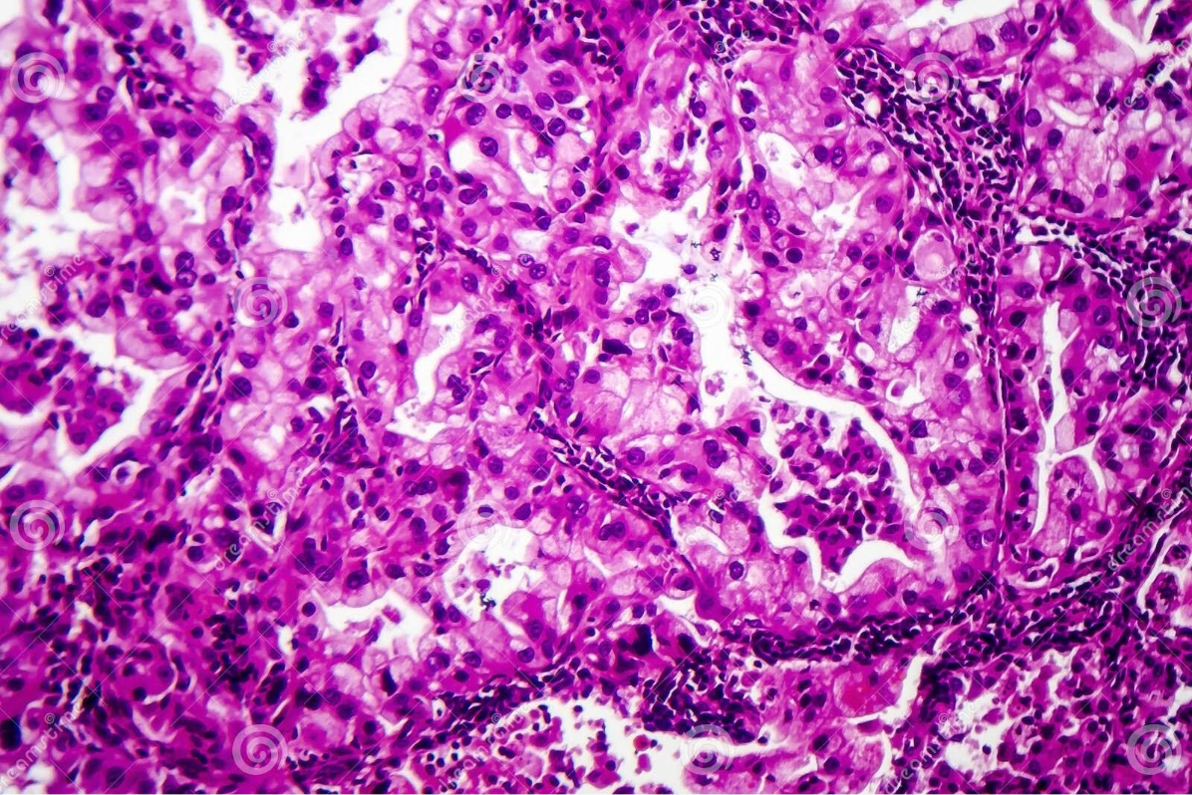
Sample Prediction Analysis
Test Case: lung cancer under microscope
The system processes a known malignant histopathology image through the complete prediction pipeline.
Input Processing
Image loaded, resized to model input dimensions, and normalised for consistent prediction.
Model Output
Lung cancer detected under microscope and predicted by CNN
Sigmoid probability generated, threshold applied, and binary classification determined.
Result Validation
Predicted class compared against true label for accuracy verification.

Slide 10
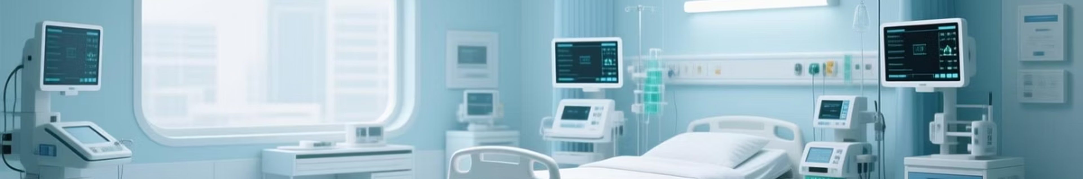
Implementation Considerations
Error Handling
Visualisation
Robust exception handling implemented for file loading errors and processing failures, ensuring graceful degradation in production environments.
Matplotlib integration provides visual feedback with predicted vs. true labels, facilitating model interpretation and debugging during development.
Scalability
Clinical Integration
Architecture supports batch predictions and can be extended to multi-class classification for different cancer types or staging systems.
Model serves as decision support tool, requiring validation by medical professionals before clinical deployment and regulatory approval.

